Slide 1
Lightweight Preprocess of 3D Conference Scenes
static scene
shell extraction
Model duplicate removal
Light baking
dynamic scene
Parametric modeling of Crowd differences
Preprocessing of bone animation
Preprocessing of texture mapping data
Networking Progressive Transmission
static scene
Fine grained transmission
Interest driven progressive transmission
Hierarchical transmission of baking map
dynamic scene
Mesh data transmission by PM
Transmission of bone animation
Hierarchical transmission of texture map
LightWeitght Web3D Rendering
static scene
Online analysis
Online assembly
instancial rendering
dynamic scene
Hierarchical reuse of model resources
Motion lightweight processing based on fragment shader
Diverse crowd rendering based on vertex shader

Slide 2
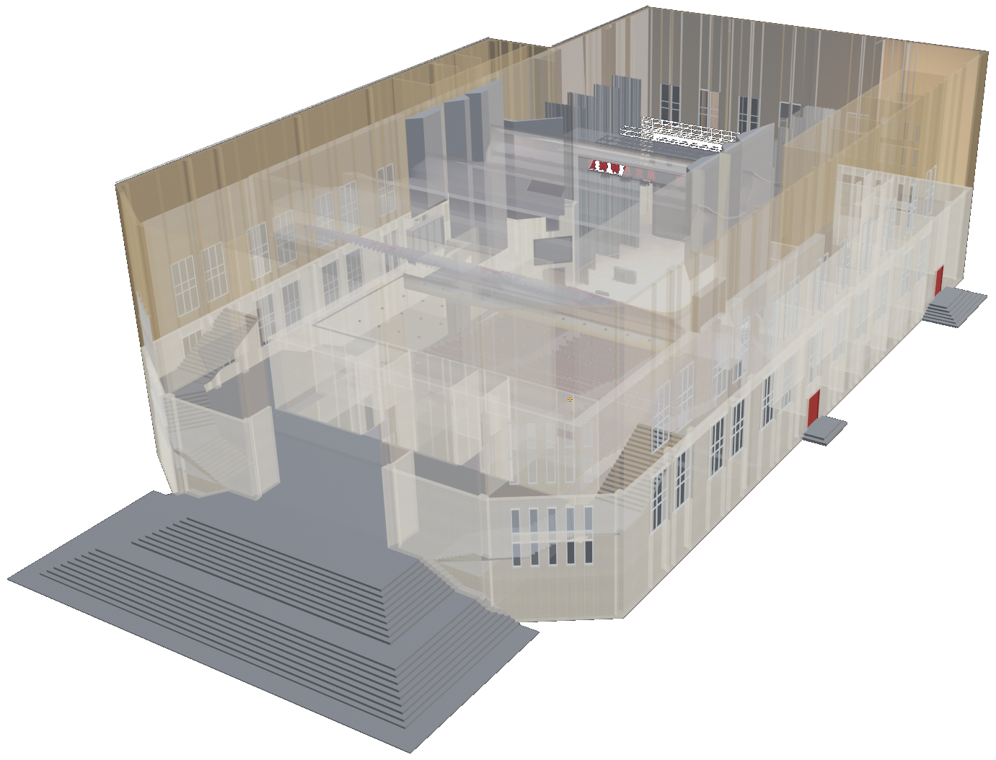
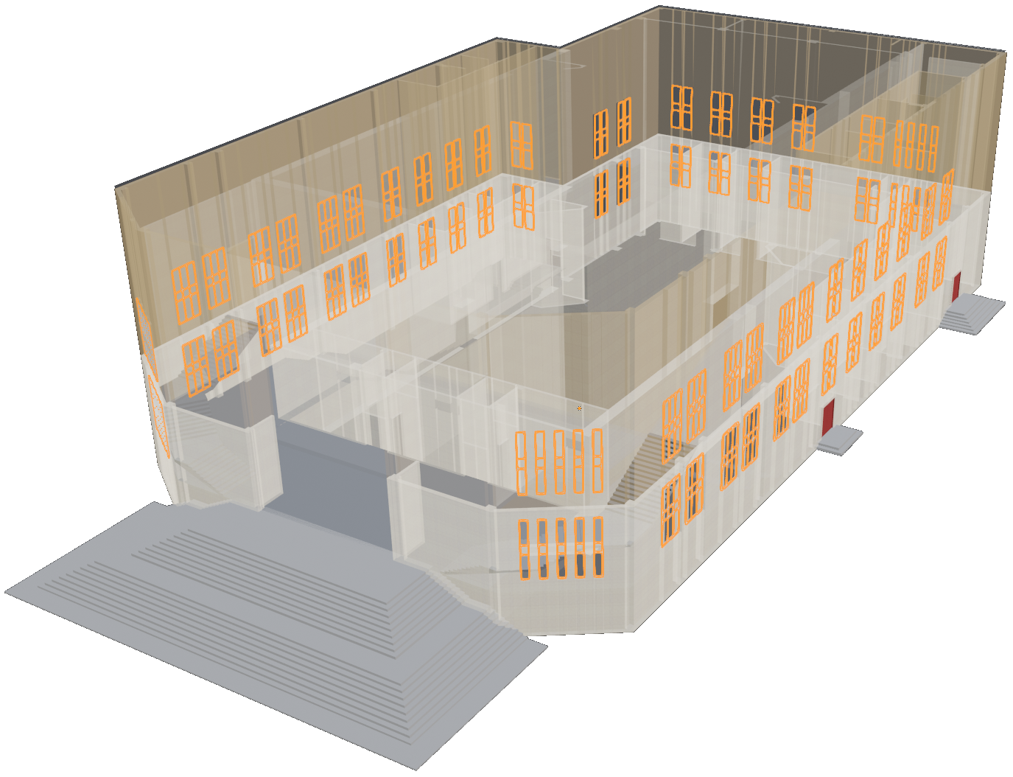
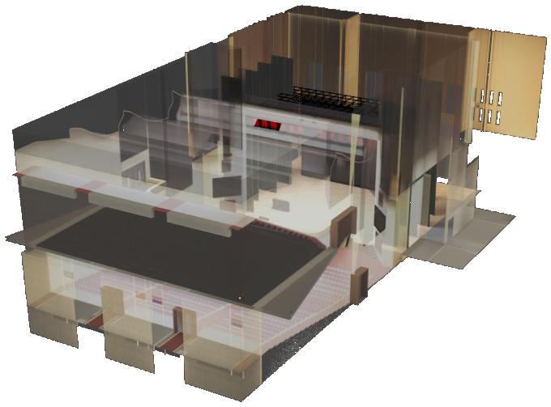
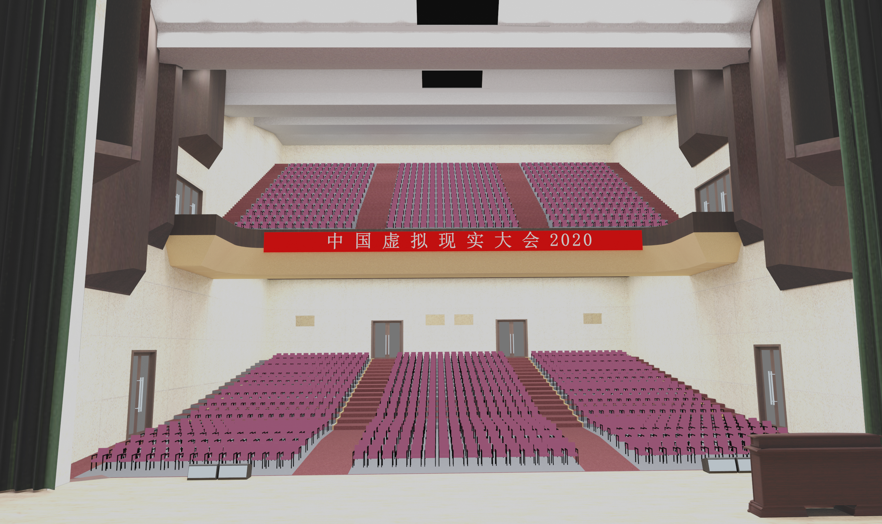
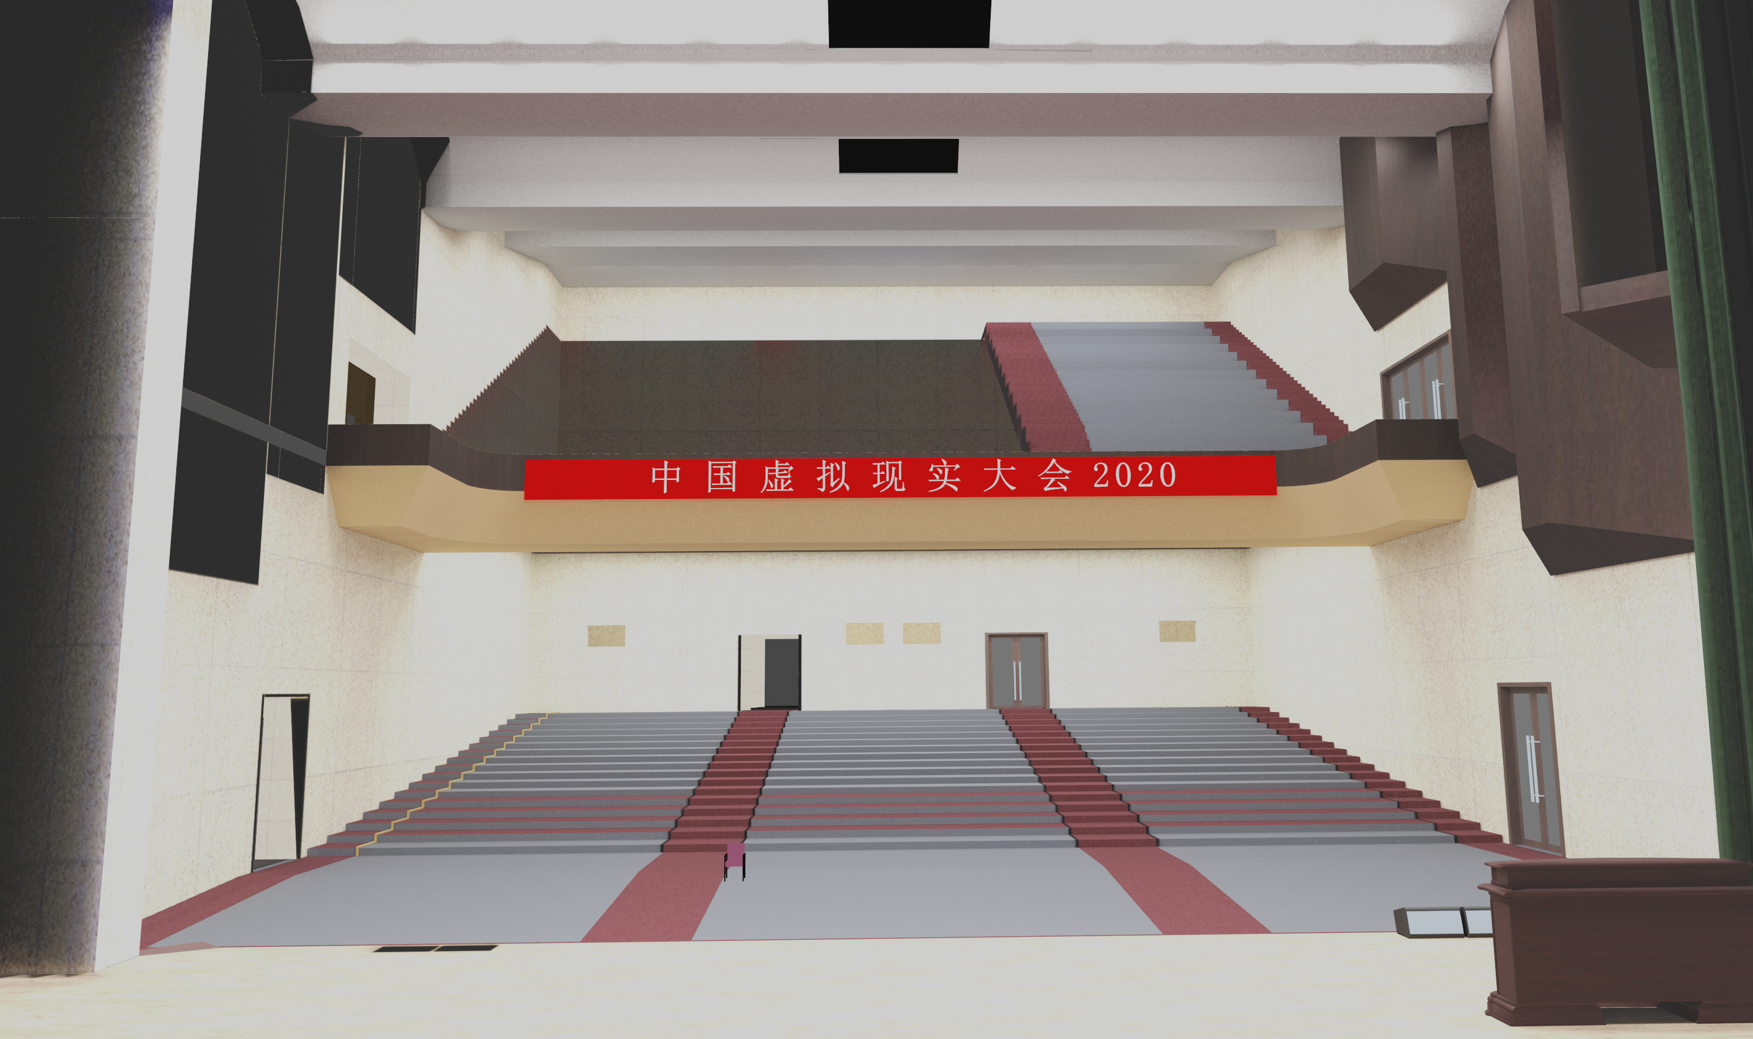

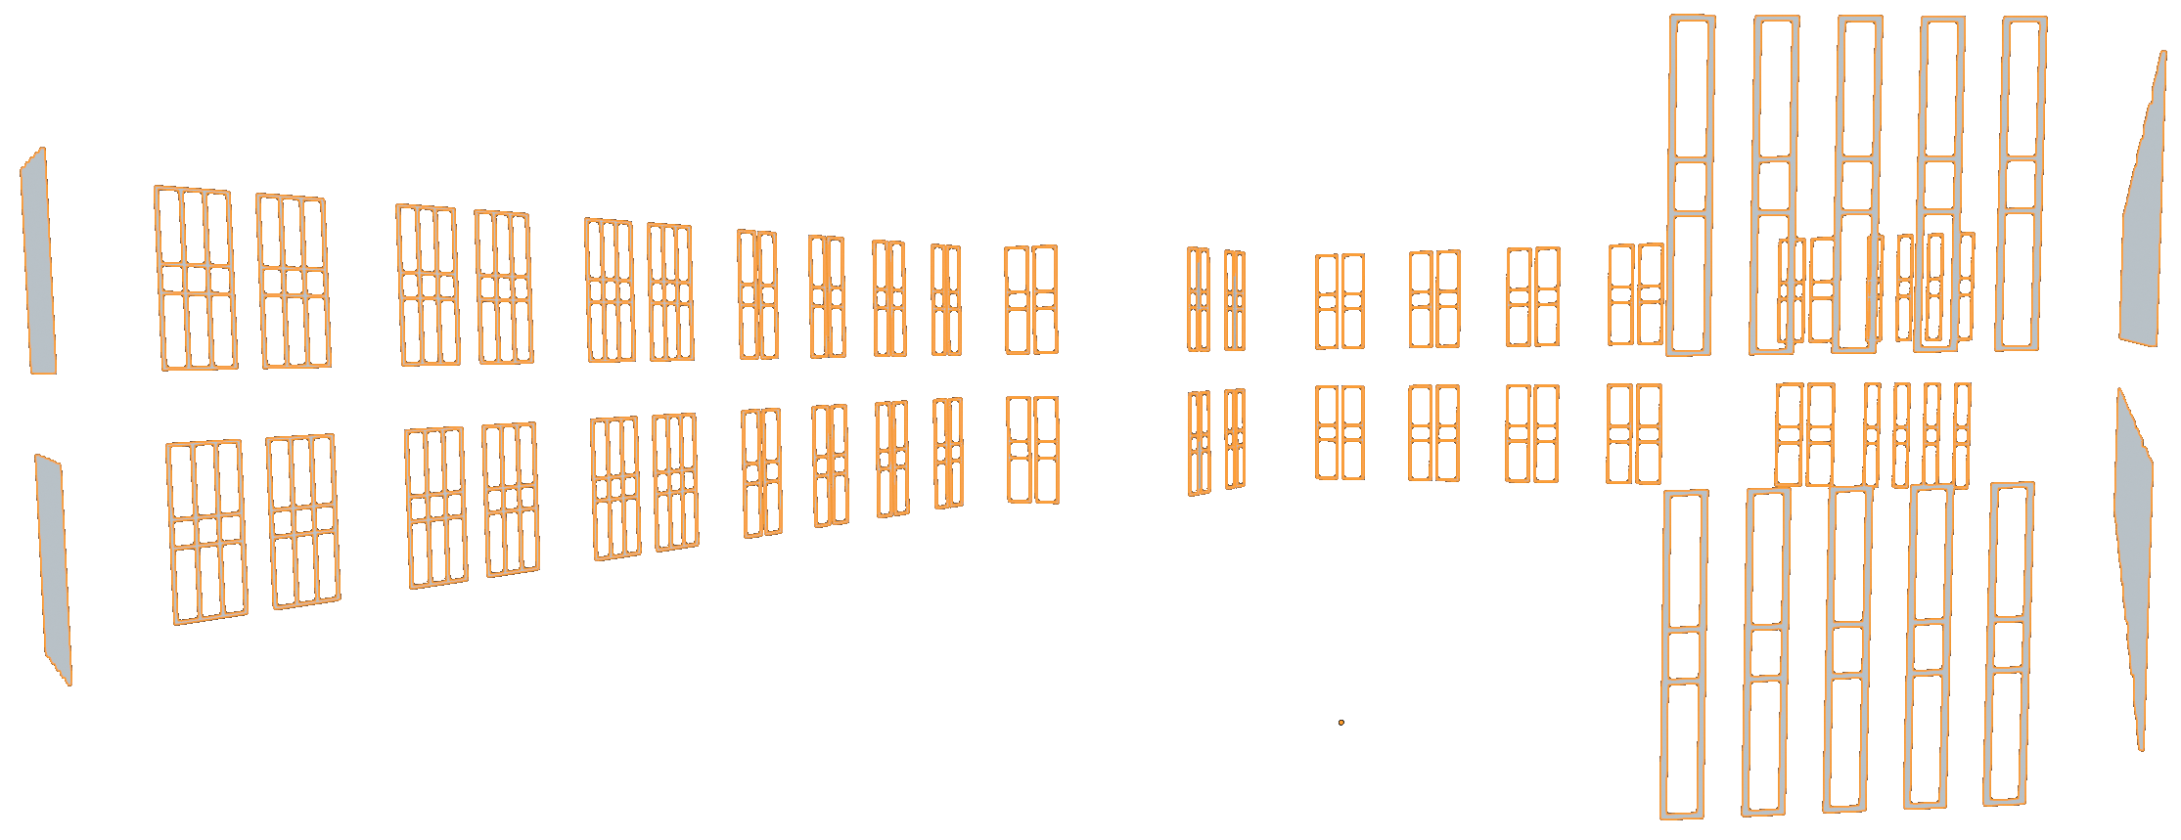

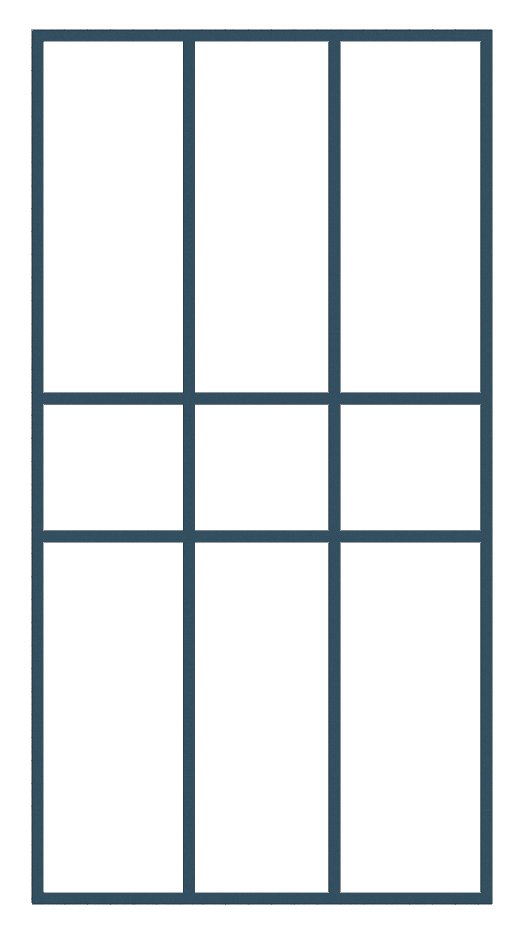
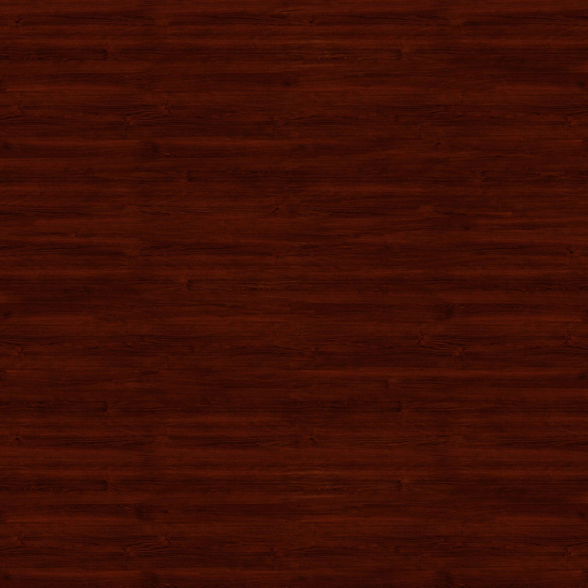
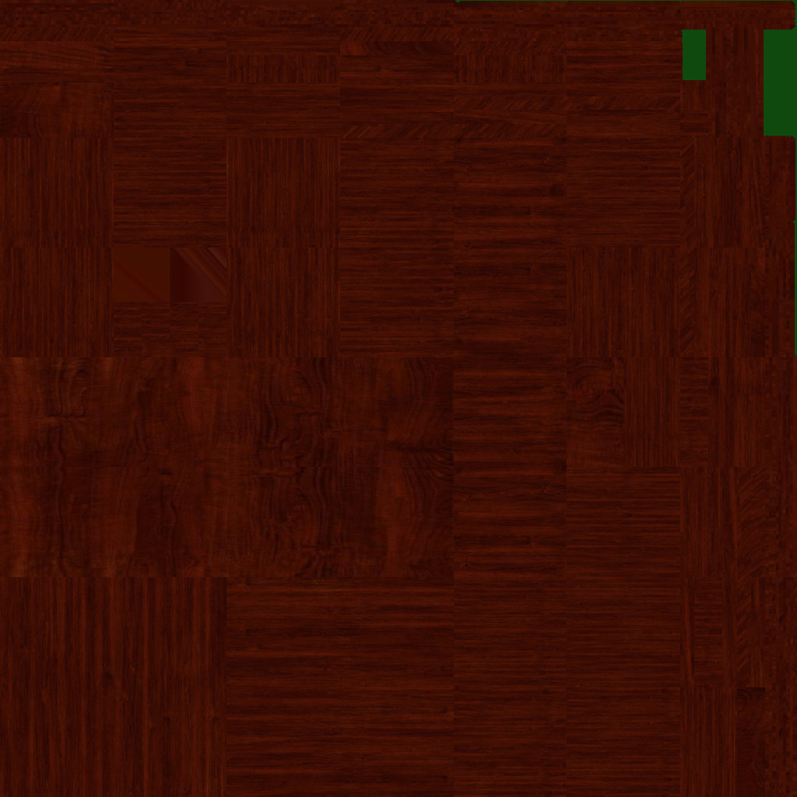
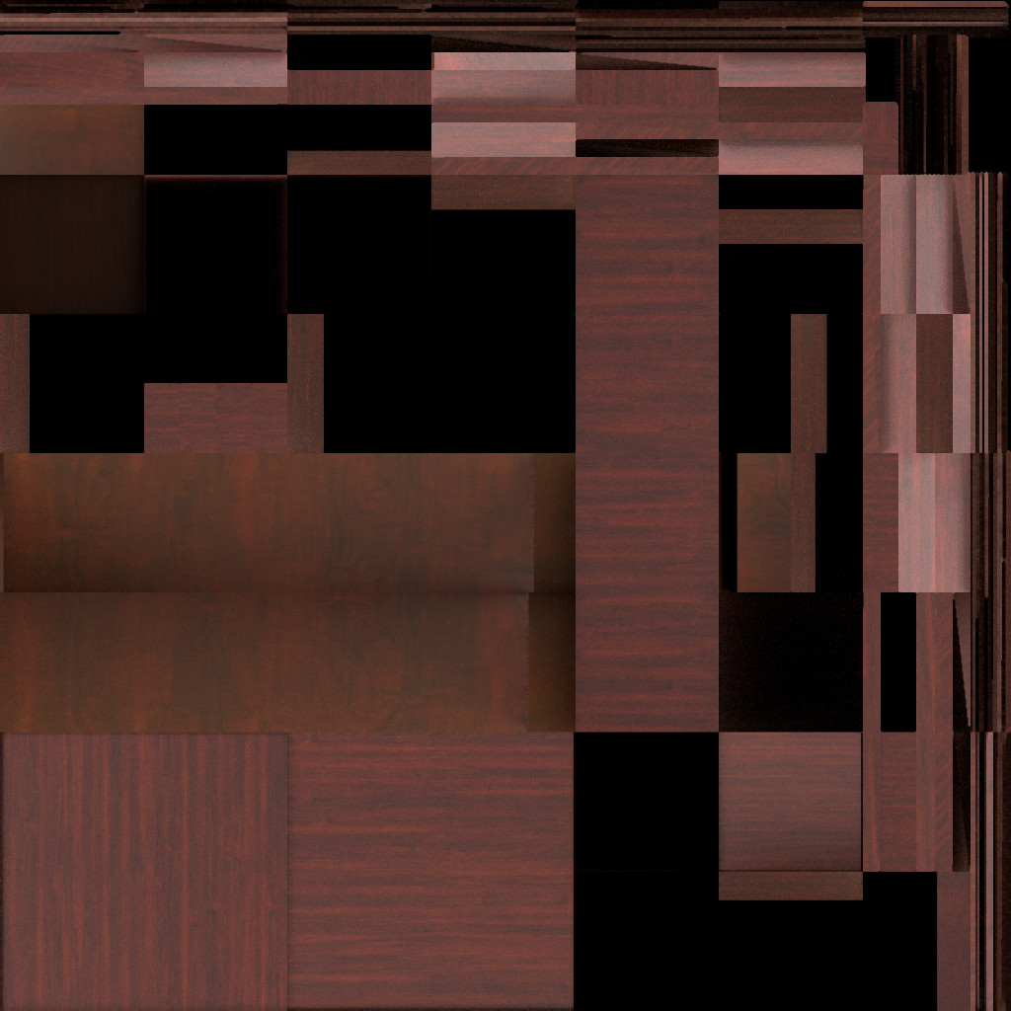
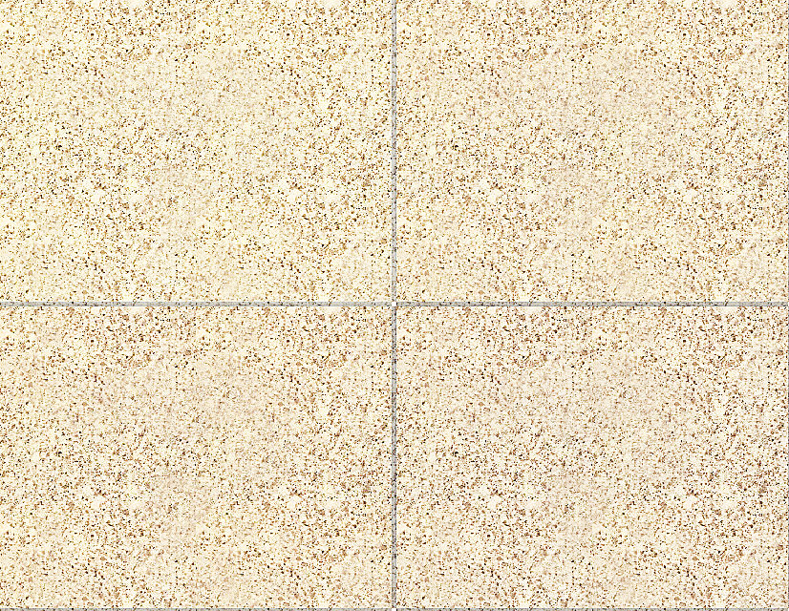
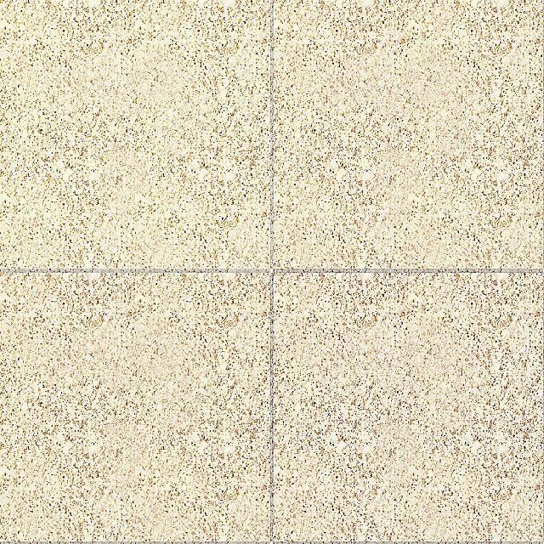
Original model
Triangulate：
370162
components：
2654
geometry：
59MB
material：
29MB
Shell part
Triangulate：
13732
components：
76
geometry：
1.13MB
material：
664KB
Internal part
Triangulate：
353393
components：
2578
geometry：
57.8MB
material：
28.4MB
shell extraction
Duplicate checking
Reusability：
36
Reusability：
28
Reusability：
24
Extracting reusable building to reduce the amount of data transferred
Material treatment
Lightweight model parameters
Triangulate：51338
components：48
geometry：8.5MB
material：10.7MB
Original
resolution：
1500*1500
data：
208KB
Initial baking
resolution：
1024*1024
data：
212KB
Light baking
resolution：
1024*1024
data：
190KB
resolution:
640*640
data：
664KB
resolution：
640*640
data：
383KB
finished
Light baking scene maps
Lightweight and standardization of materials
Optimize the material mapping

Slide 3
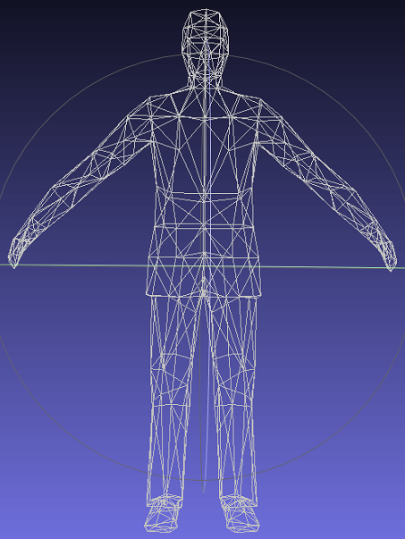
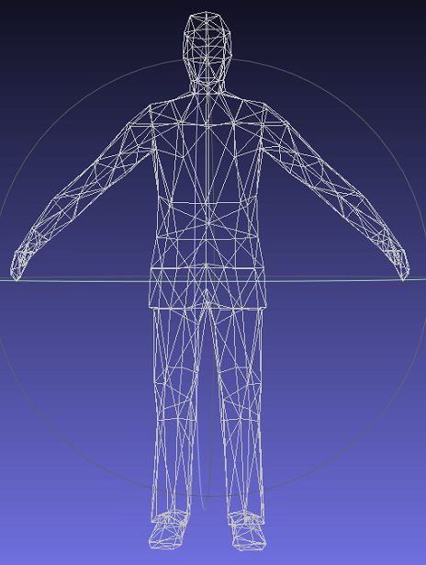
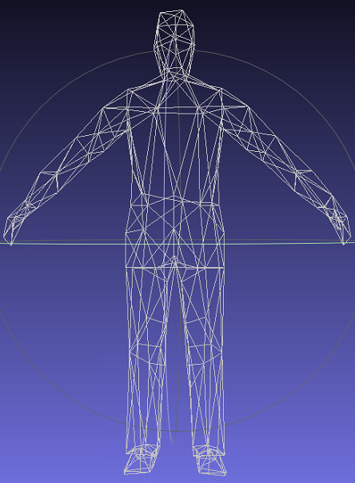
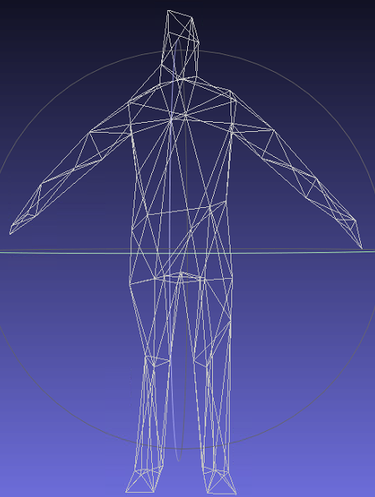
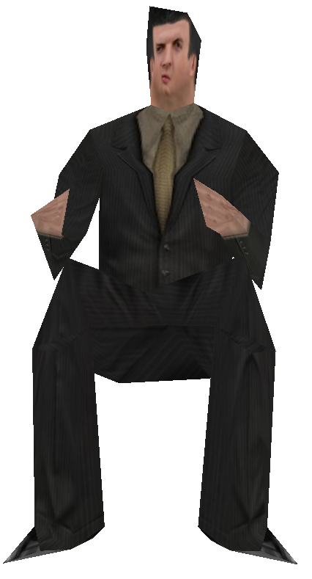
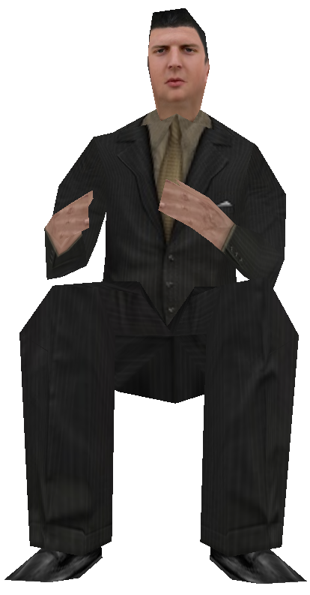
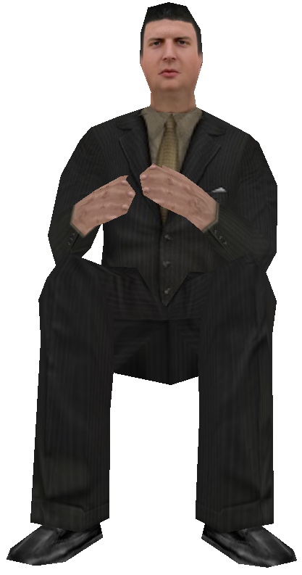
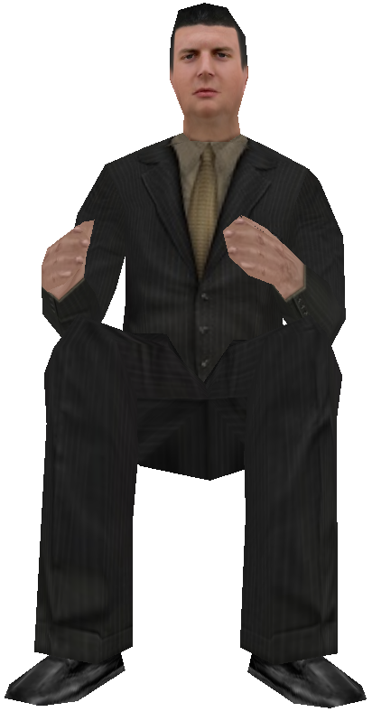
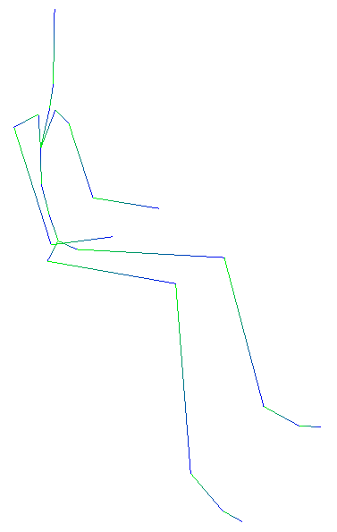
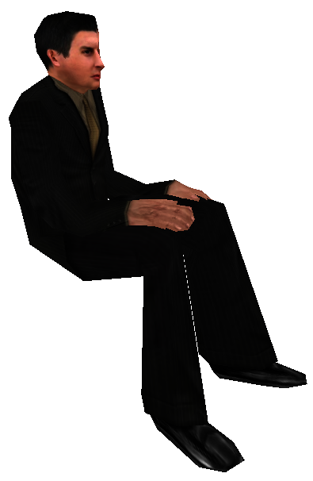
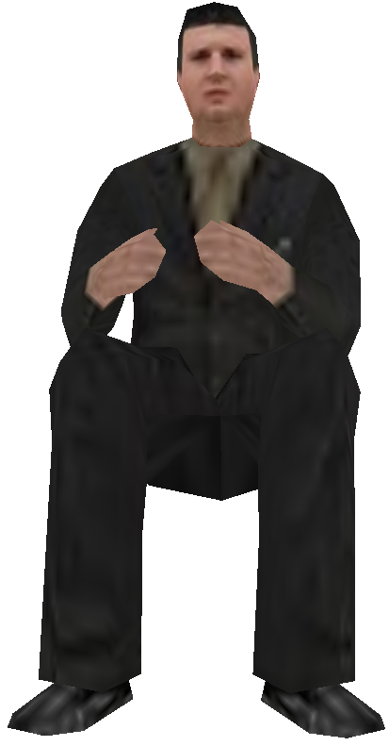
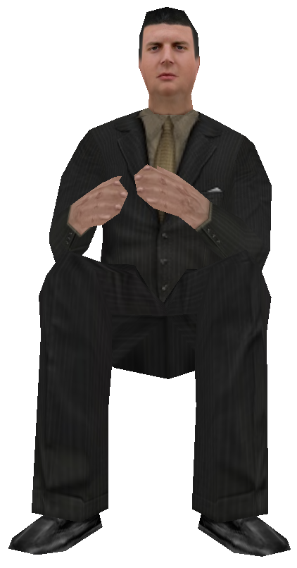
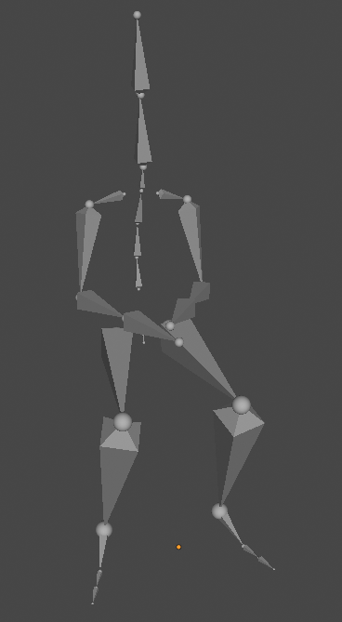
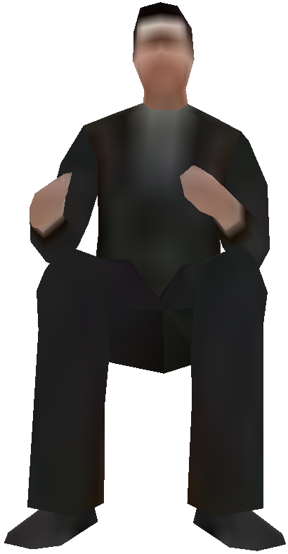
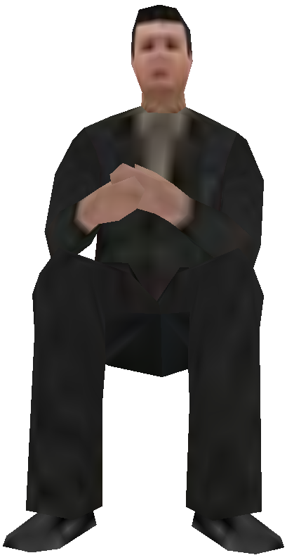
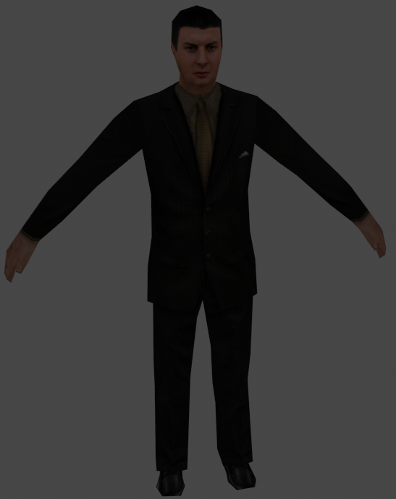
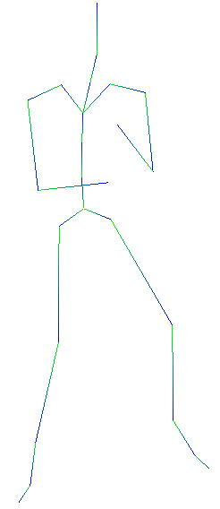
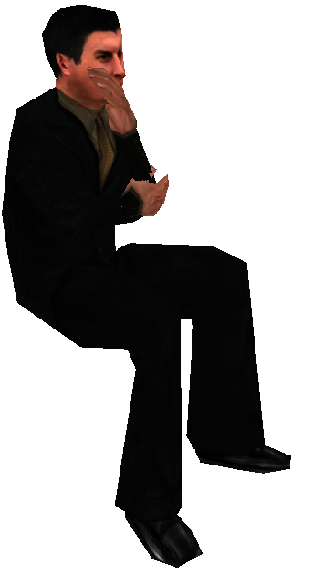
server
transmission
client
Mesh simplification
data stream
Mesh fineness improvements
base mesh
Model geometry
packet1
packet2
Faces:592
Faces：540
Faces：340
Faces：140
Faces：140
Faces：340
Faces：540
Faces:592
packet3
record3
record2
record1
increment1
increment2
increment3
Hierarchical preprocessing of texture mapping
Skeleton animation
skeleton animation extraction
Texture mapping
Parameter adjustment
pixel:32×32
pixel:64×64
pixel:128×128
pixel:512×512

Slide 4
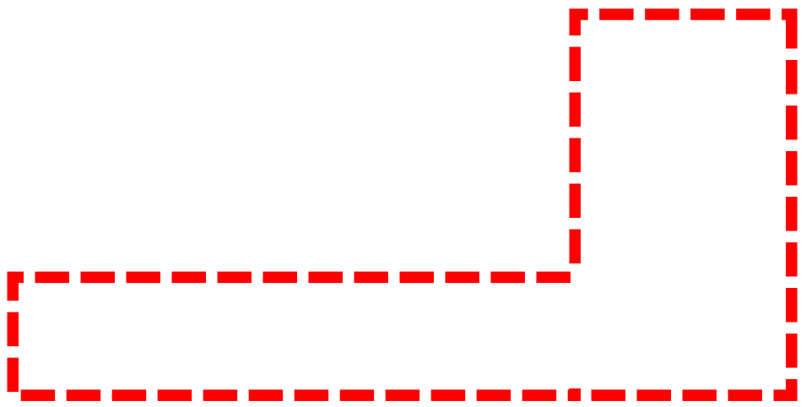
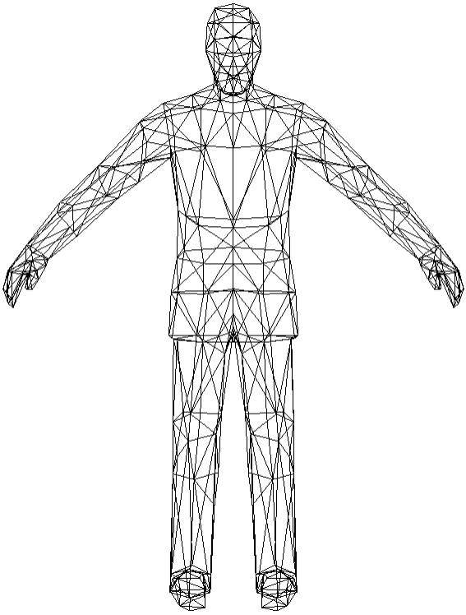
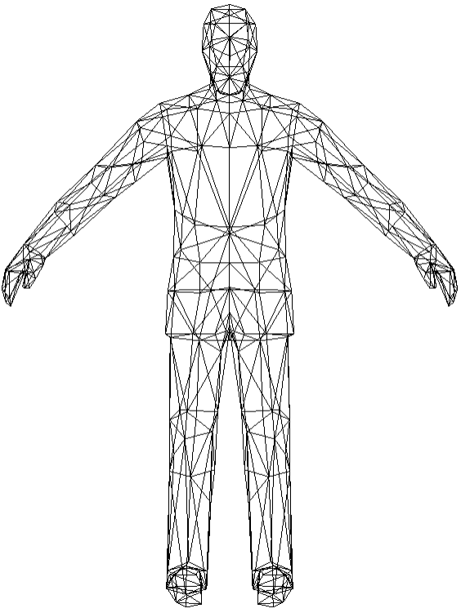
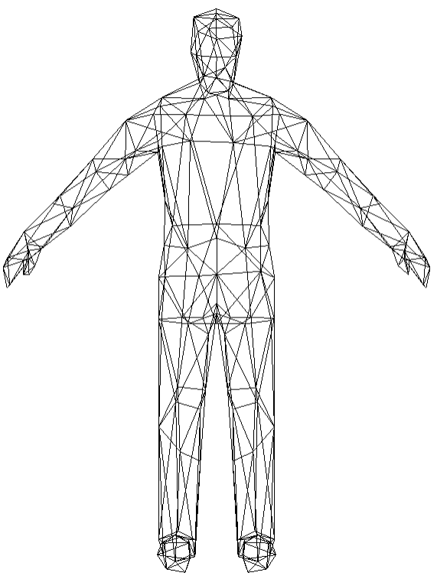
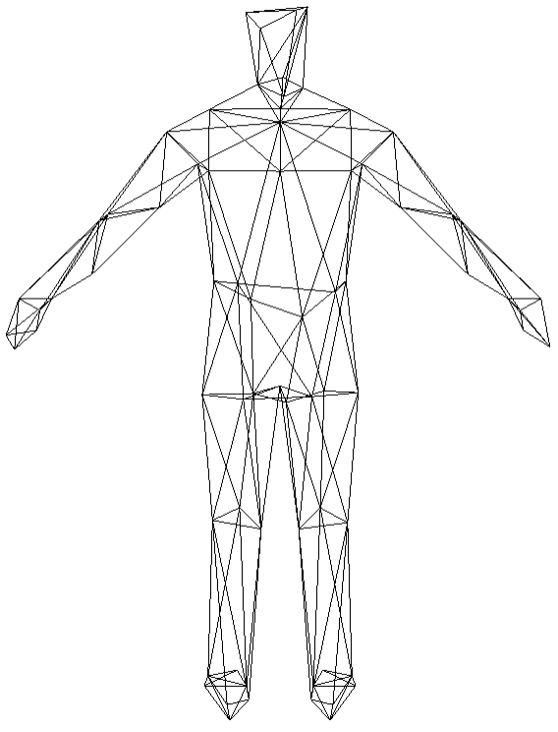
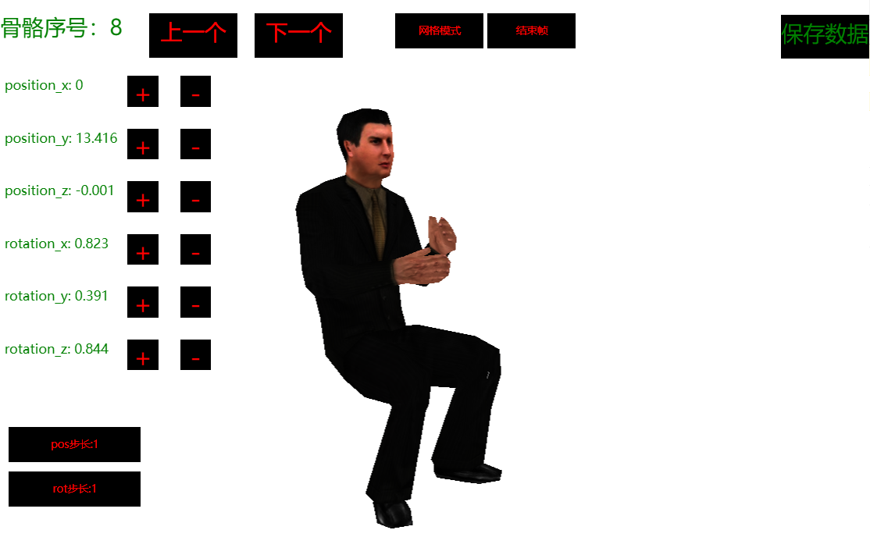
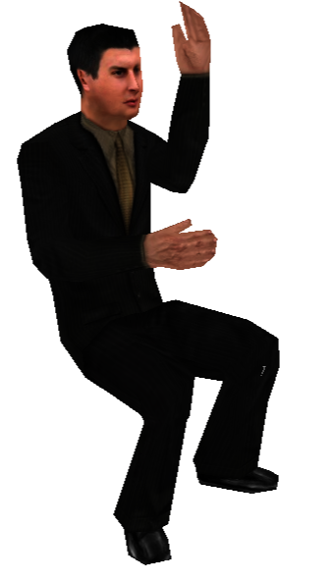
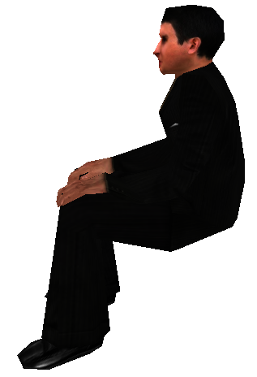
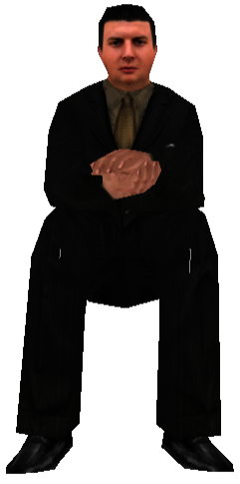
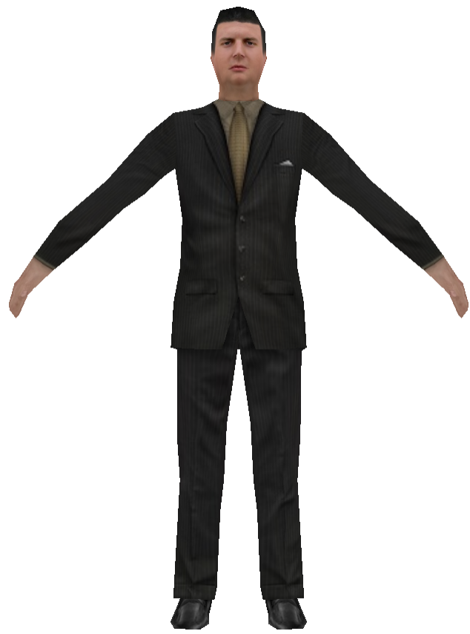
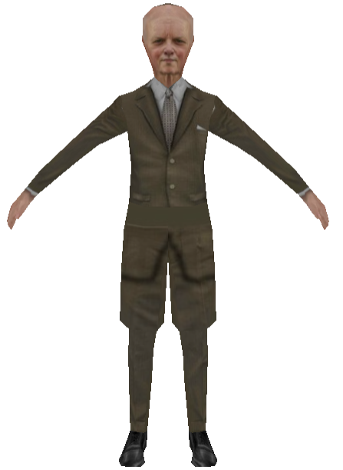
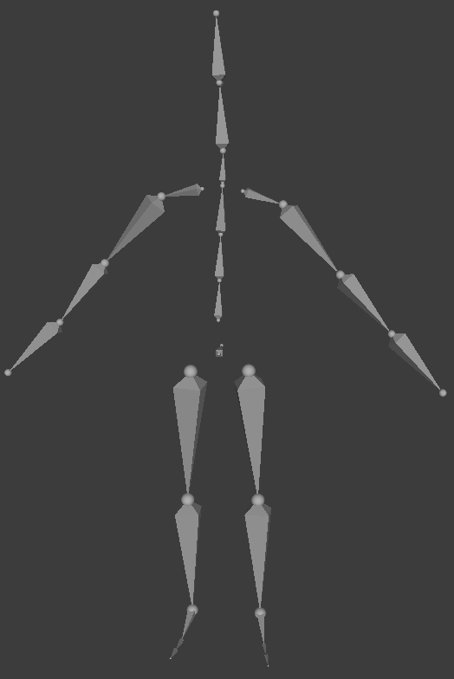
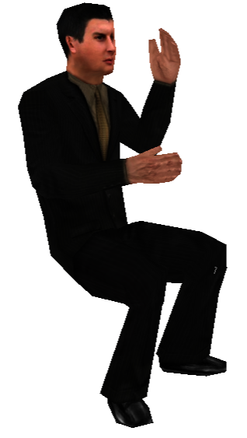
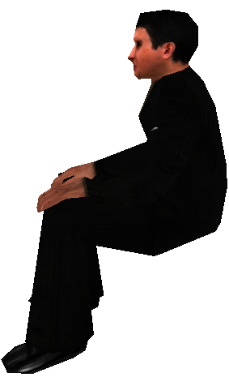
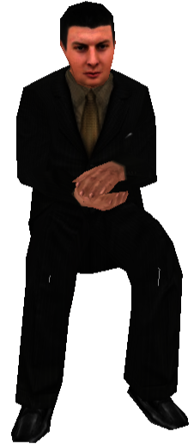
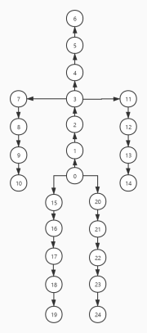
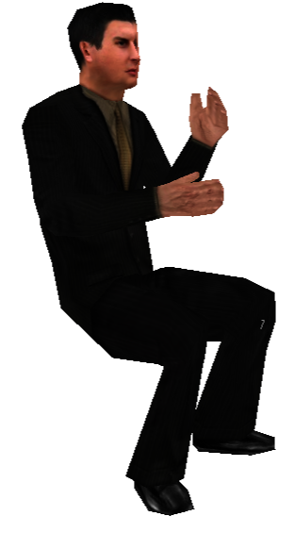
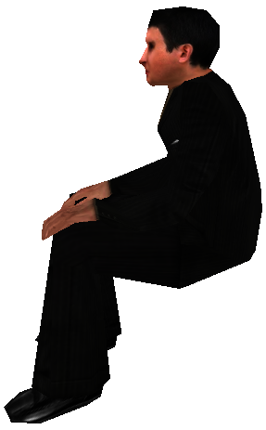
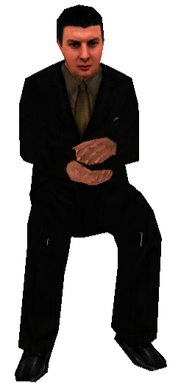
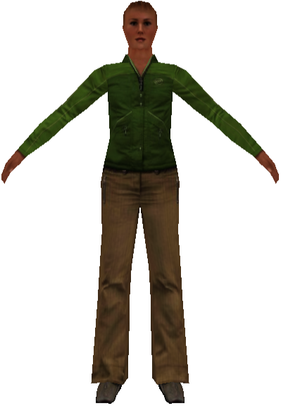







Server
Transmission
Browser
Mesh Merging
Mesh Spliting
Mesh Stream
BM
Record₁
PM3: 592
PM2: 540
PM1: 340
Base Mesh: 140
Record₂
PM0:140
PM1:340
PM2:540
PM3:592
Record₃
Record₂
Record₁
Record₃
Record₁
Record₂
Record₃
-
-
-
+
+
+
Server
Transmission
Browser
edit start frame
Skeleton analysis
Motion Generator
Skeleton extraction
Calculate transition frame
edit end frame
Motion Generator

Slide 5




Uniform一致变量
采样器
Uniform一致变量
采样器
模型视图矩阵
投影矩阵
时间
骨骼动画数据
纹理贴图
贴图个数
Attribute属性变量
Varying变量
顶点数据
顶点的原坐标
顶点的UV
骨骼索引
顶点所在部位
贴图类型
色调
对象数据
变换矩阵
动画播放速度
动画类型
贴图类型
色调
内建输出变量
内建输出变量
顶点屏幕坐标
片元颜色

Slide 6
vextex shader
fragment shader
sampler
纹理贴图
sampler
对象attribute data
顶点attribute data
对象的变换矩阵
动画播放速度
动画类型
贴图类型
色调
骨骼动画数据
Uniform data
顶点的原坐标
顶点的UV
骨骼索引
贴图个数
Uniform data
模型视图矩阵
投影矩阵
时间
varying data
vating data
贴图类型
色调

Slide 7
vextex shader
fragment shader
sampler
模型的基本信息
添加动画
纹理贴图
sampler
对象attribute data
顶点attribute data
对象的变换矩阵
动画播放速度
动画类型
骨骼动画数据
Uniform data
顶点的原坐标
顶点的UV
贴图个数
Uniform data
时间
varying data
Uniform data
贴图类型
色调
模型视图矩阵
投影矩阵
顶点attribute data
骨骼索引

